Slide 1
Hardware Capabilities Exposure
Gaurav Agrawal, Shashikanth

Slide 2
Requirement Overview
Requirements
On portal List Hardware Capabilities including GPU/ NPU etc. (only externally configured value, not available one)
Capabilities display per edge
List of consumers per capability per edge.
TBD: List of capabilities used per application
Capabilities Registration/ Exposure
Hardware Capabilities – Registers as external system to MECM-Inventory by administrator and exposed by MECM-Inventory
Future Considerations
1. Usage of these capabilities during Orchestration
2. Maintain Availabile inventory for these capabilities by dynamically getting the initial & current usage/availability status.
Notes:
https://gitee.com/edgegallery/community/blob/master/Security%20WG/Tutorials/Gitee%20Pull%20Request%20Compliance%20Verification.md

Slide 3
HW Capability Exposure Solution
1
Registers HW Capabilities
Existing API, Parameter Additions
POST /inventory/v1/tenants/{tenant_id}/mechosts
PUT /tenants/{tenant_id}/mechosts/{mechost_ip}
MECM-FE
Additional Input
{
"hwcapabilities": {
"type": "GPU",
"vendor": "testvendor",
"model": "testmodel",
"specification": [
{
"spectype": "noofcards",
"specvalue": "2"
}
]
}
}
public class HwCapability { private String type; private String vendor; private String model; private HwSpecs specs; } public class HwSpecs { private List<HwSpec> specs; }
public class HwSpec { private String spectype; private String specvalue; }
Application Instantiation
with HW capabilities details
Get per node HW Capabilities
Get per node/per capability consumers
2
4a
4b
1
MECM-APPO
MECM-Inventory
3
Add to Inventory
2
Application Instantation
3
Add to Inventory
4a
Get per node HW capability
Existing API, Parameter Additions
POST /appo/v1/tenants/{tenant_id}/app_instances
Additonal Variable:
List<HwCapabilities>
{
hwcapabilities: [capability1, capability2]
}
NEW API
GET /tenants/{tenant_id}/mechosts/ {mechost_ip}/app
{
“appid” : “id1”,
“appname: “appname1”
“capabilities”: [capabilityType1, capabilityType2]
}
NEW API
GET /tenants/{tenant_id}/mechosts/ {mechost_ip}/capabilities
Additional Output
{
"hwcapabilities": {
"type": "GPU",
"vendor": "testvendor",
"model": "testmodel",
"specification": [
{
"spectype": "noofcards",
"specvalue": "2"
}
]
}
}
4b
Get per node per HW capability applications
NEW API
GET /tenants/{tenant_id}/mechosts/ {mechost_ip}/capabilities/{capability_type}/applications
{
apps: [
{
“appid” : “id1”,
“appname: “appname1”
}
Notes:
https://gitee.com/edgegallery/community/blob/master/Security%20WG/Tutorials/Gitee%20Pull%20Request%20Compliance%20Verification.md

Slide 4
Inventory DB Changes
0..n
Applications
Added by APPO
Also it’s associations are added by APPO
Edge contains
Applications
1
0..n
Edge (MECHost)
Capability is related to Applications
1
Edge contains
HwCapability
0..n
0..n
HwCapability
Added by Administrator

Slide 5
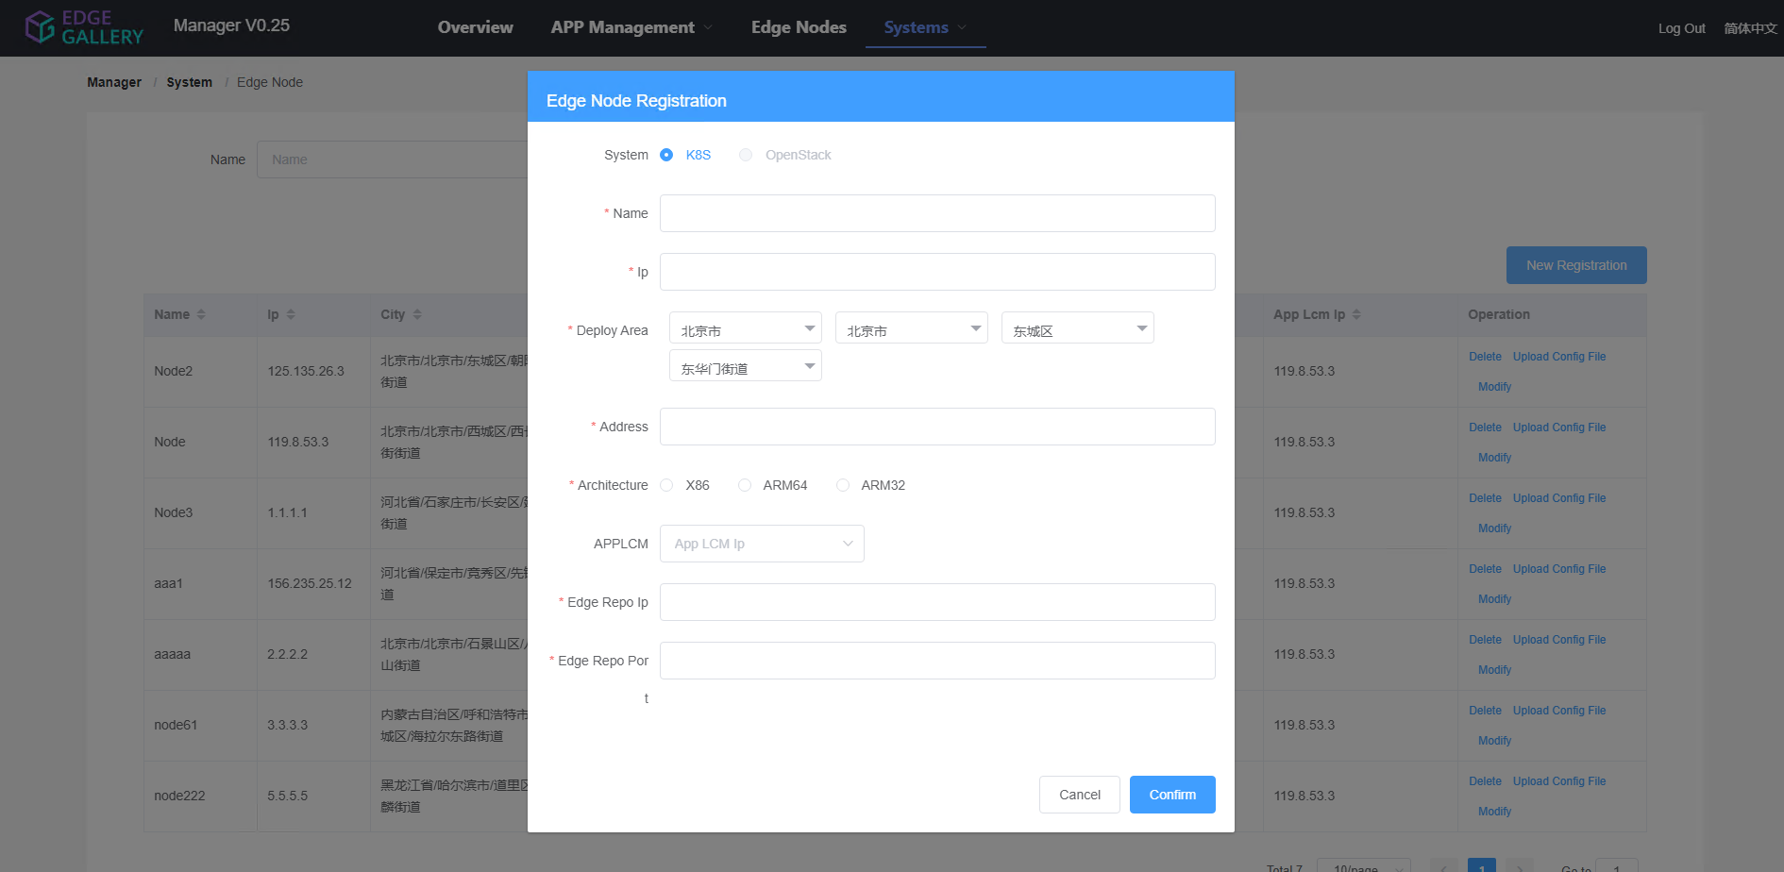
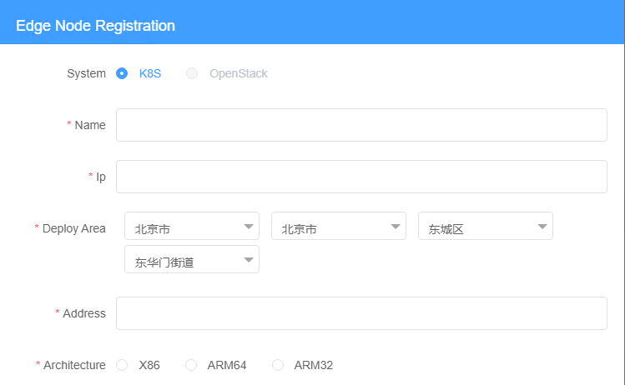

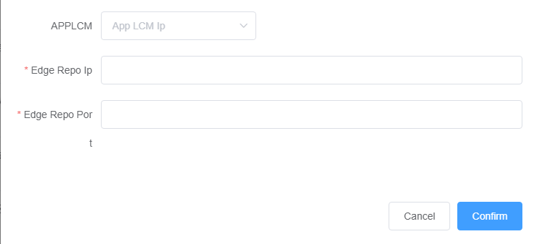
MECM-FE Design (TBD: YangYang)
HW Capabilities

Slide 6
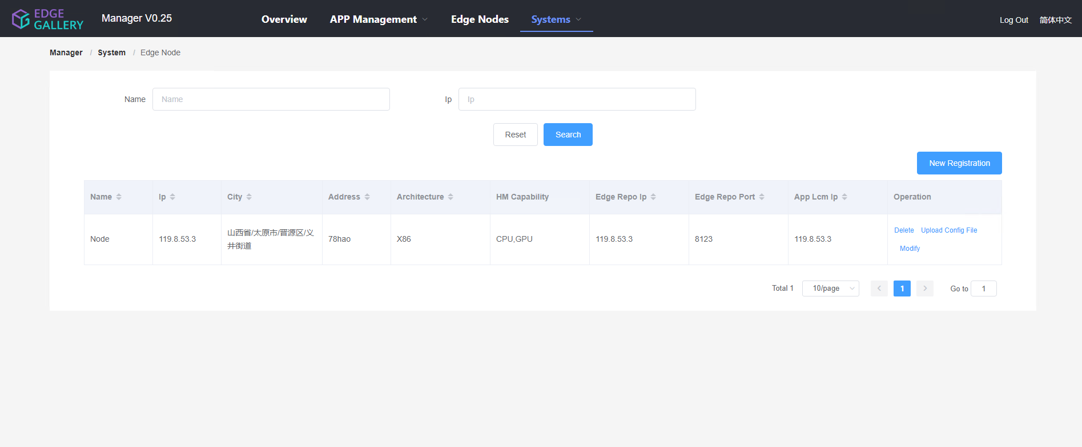
MECM-FE Design (TBD: YangYang)

Slide 7
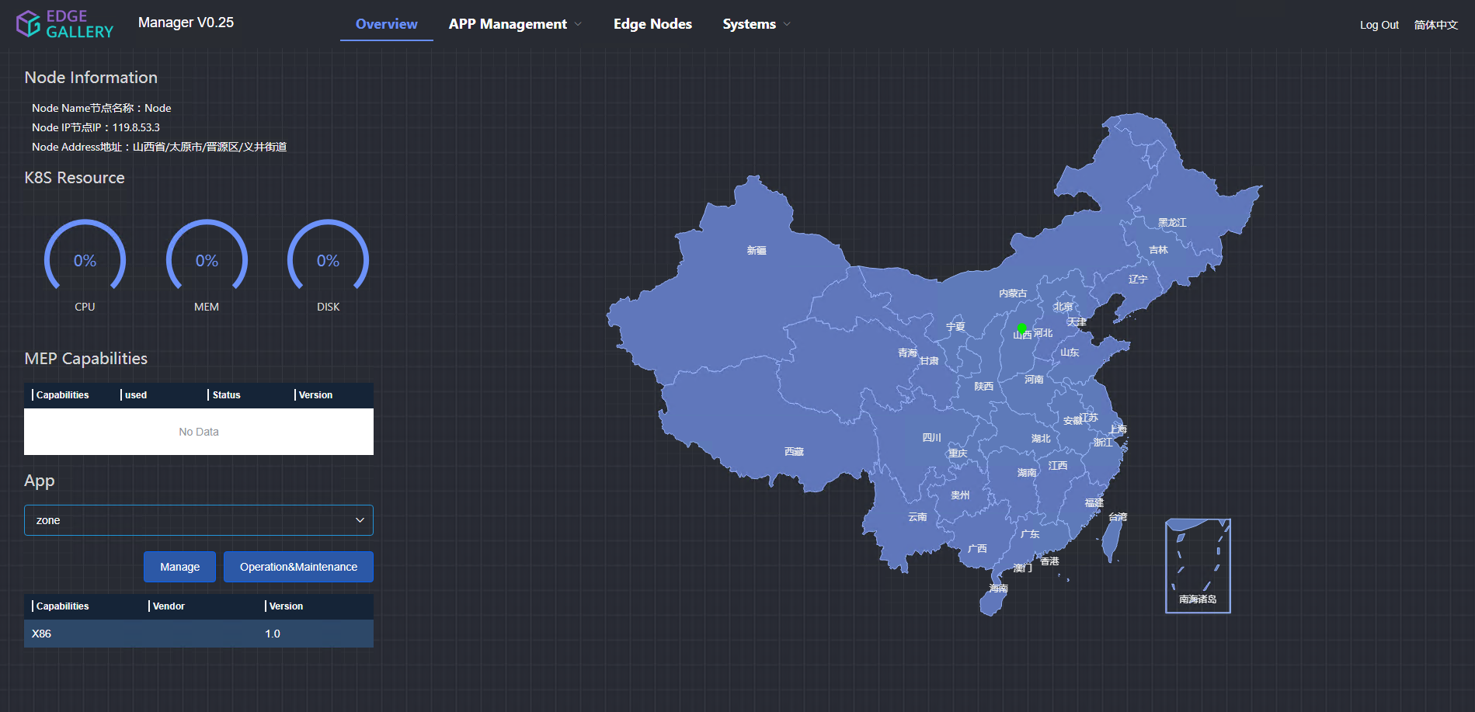

MECM-FE Design (TBD: YangYang)
Need to discuss what should be shown here
CPU,GPU
NA
NA
NA
Hardware capability
Status
Software capability
ExampleService
Active
1.0

Slide 8
Security Impact
Notes:
https://gitee.com/edgegallery/community/blob/master/Security%20WG/Tutorials/Gitee%20Pull%20Request%20Compliance%20Verification.md

Slide 9
Thanks

